Slide 1


DressMeUp
Athens University of Economics and Business
MSc in Business Analytics
Machine Learning & Content Analytics Course

Slide 2
01
The Problem
Agenda
02
Our Solution
03
Data
04
Algorithms & Experiments
05
Results & Quantitative Analysis
06
Qualitative & Error Analysis
07
Discussion
08
Our Team

Slide 3
The Problem
Problems Definition & why it interests people

Slide 4
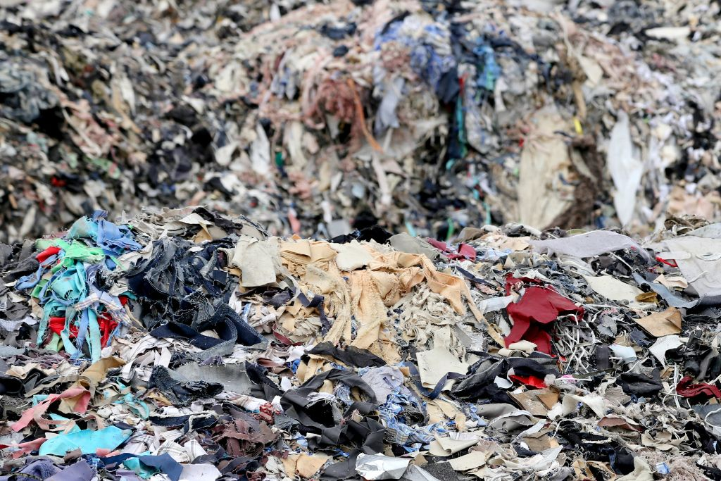
Notes:
The main problem we want to tackle is the vast amount of cloth-related waste created by humans.

Slide 5
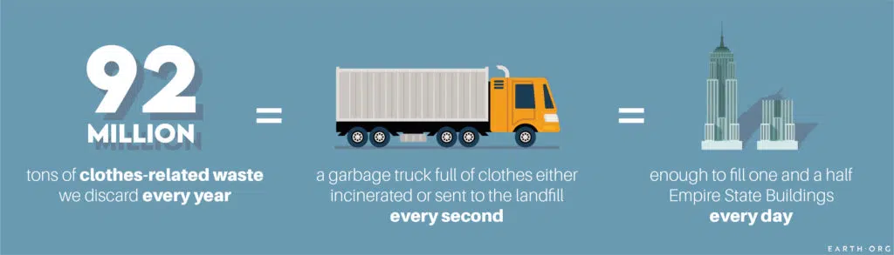
Problem: Environmental Risk
Notes:
According to recent studies we create 92 million tons of this type of waste every year
Produces half a million tons of microplastics
You’ve surely heard of the plague of microplastics, now seemingly ubiquitous on Earth. They are found everywhere, from the top of Mount Everest, to within the very air we breathe. The oceans are riddled with them, routinely ingested by fish, which are then eaten in turn as the plastic works its way up the food chain.
Garments are a huge source of microplastics because so many are now made of nylon or polyester, both durable and cheap. Each wash and dry cycle, especially the latter, sheds microfilaments that move through our sewage systems and end up in waterways. We estimate that half a million tons of these contaminants reach the ocean each year.

Slide 6
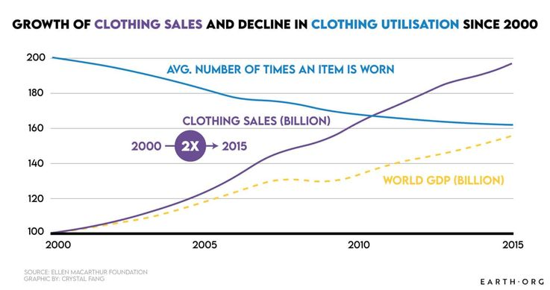
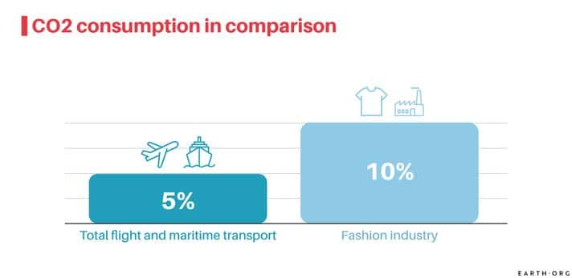
Problem: Environmental Risk
+
World Economy Loss
Notes:
These two statistics are the embodiment of fast fashion. Clothing sales doubled from 100 to 200 billion units a year, while the average number of times an item was worn decreased by 36% overall.
1. More than $500 billion are lost every year due to lack of recycling and clothing utilization
Garments given up early and thrown out instead of recycled combine to produce massive wastage, estimated at around $500 billion every year. A large portion occurs on the consumer’s side, but retail stores are just as guilty, often spotted tossing or burning unsold stock.
2. Fast fashion generated more CO2 than aviation and shipping combined

Slide 7
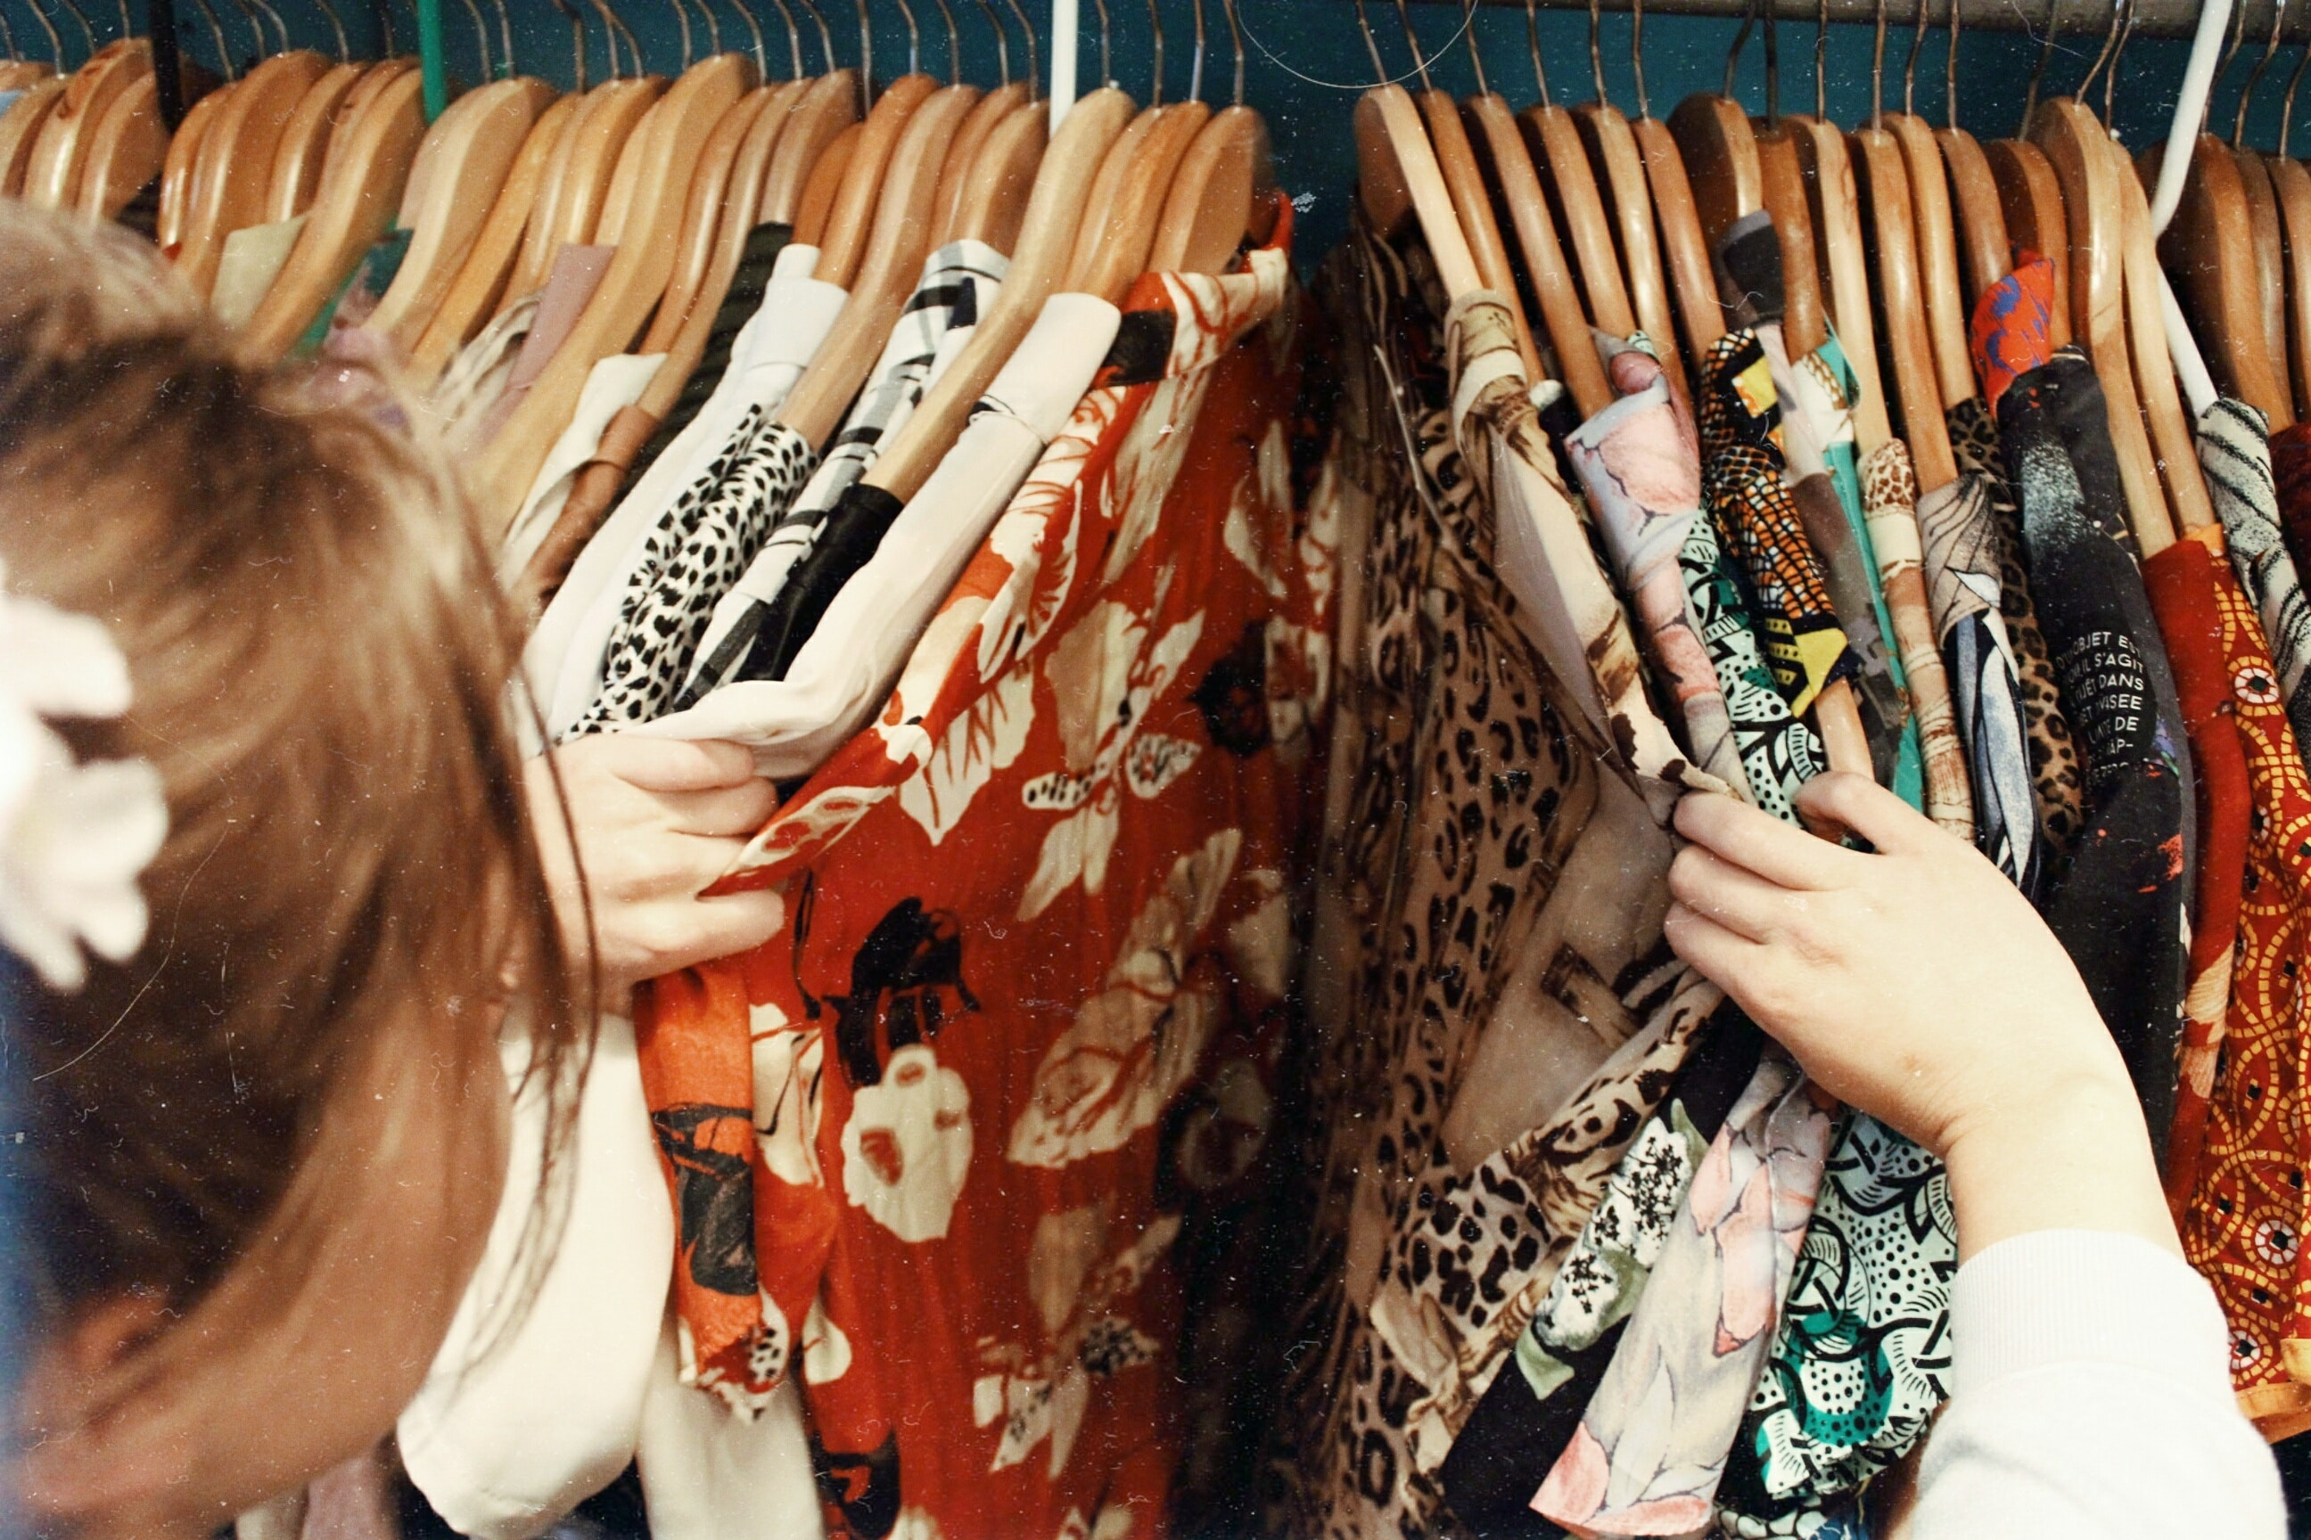
Notes:
So what do we do with all the clothes in our wardrobes?
Clothes that we have, but don’t wear either because we don’t know how to combine or don’t want to wear at all..?

Slide 8


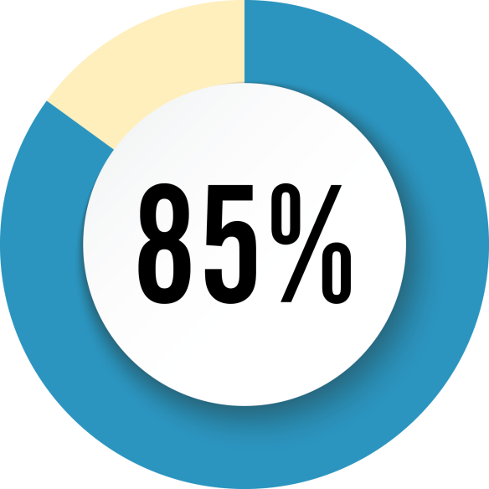
Problem: Environmental Risk +
World Economy Loss +
Individual Economy
Women have clothes in their wardrobe that don't fit
Men and women’s wardrobe clothes are not worn
Items of clothing at least on average are never worn
Source: https://www.theguardian.com
Source: https://fashionunited.uk
Source: https://www.mirror.co.uk
Notes:
All of us have clothes in our wardrobe that we do not use.

Slide 9
U.S. Consumers’ Interest in Fashion
Source: © Statista 2023
Notes:
But as we can see from this graph, especially in the orange area, and the next slide..
Release date
October 2017
Region
United States
Survey time period
September 15 to 18, 2017
Number of respondents
926 respondents
Age group
18 to 69 years

Slide 10
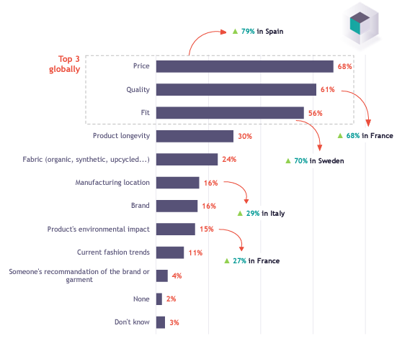
YouGov
European Fashion Report 2021
Criteria when buying clothes
Notes:
People are very interested in buying clothes. Especially considering price.

Slide 11
YouGov
European Fashion Report 2021
Notes:
And the selling frequency seems be at an all time high point.

Slide 12
YouGov
European Fashion Report 2021
Notes:
At the same time second hand shops is the number 2 preferred way of buying clothes, further emphasizing the room for entrepreneurship in that area.

Slide 13
Our Solution
Our Vision & Goals

Slide 14
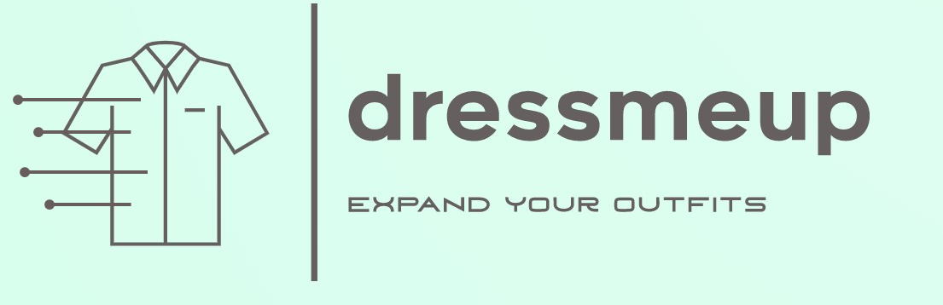


Our Solution
Notes:
DressMeUp is an Artificial Intelligence (AI) application that creates outfit combinations and recommendations for purchases. It uses your existing pieces of clothing in order to create outfits based on a certain occasion, time of day or weather conditions. It scouts the web for existing and upcoming fashion trends and learns what clothing combinations work together. As an API, it can be integrated into the websites of clothing e-shops and match selected pieces of clothing from the e-shop’s to the ones from the user’s wardrobe. Users can sell their clothes through the application and buy from other users or from partnered e-shops.

Slide 15



How to access
Mobile App
Partnered e-shops
As an app, on Android and iOS devices.
As an API, through e-shops’ webpages
Webpage
As a webpage, on a browser using a PC, tablet, mobile or whatever else.

Slide 16






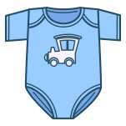
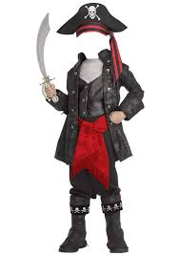

How it will work
Notes:
So, how does it work?
As an application you log into your account from your phone or the web and you can
Get new outfits put together from your existing wardrobe
Plan your weekly outfits
Search for clothes you don’t use often and either push them higher for them to be included in future outfits or sell them to other users
Get recommendations for new clothes that match your existing ones
As an API you can find our system embedded into the e-shops of clothing shops where you can use it to select an item from the e-shop and see what clothes from your wardrobe it can go well together

Slide 17

Competition Analysis
Functionality | DressMeUp | Acloset | Whering | OpenWardrobe
Add clothes
Make outfits
Plan outfits
Sell clothes
Buy clothes
Track clothes usage
AI uses weather forecast
AI uses occasion formality & time of day
E-shops embedded API
Notes:
Seeing our competition at the moment, we can that Acloset and Whering are in a good spot, but with the additional capabilities of our application ALONG with the API, we will be not only differentiated, but far ahead.

Slide 18
Data
Collection, Overview & Processing

Slide 19
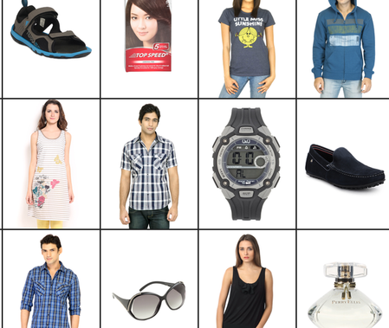




Data Collection
Fashion Product Images Dataset, containing 44k+ products with multiple category labels, descriptions and high-resolution images. It is our primary dataset, from which most of our data came from.
Size: 25 GB
Kaggle
Digital Version of Sanzo Wada’s ‘A Dictionary of Color Combinations’ book, containing 300+ combinations from 150+ unique colors.
Size: 23 MB
GitHub

Slide 20
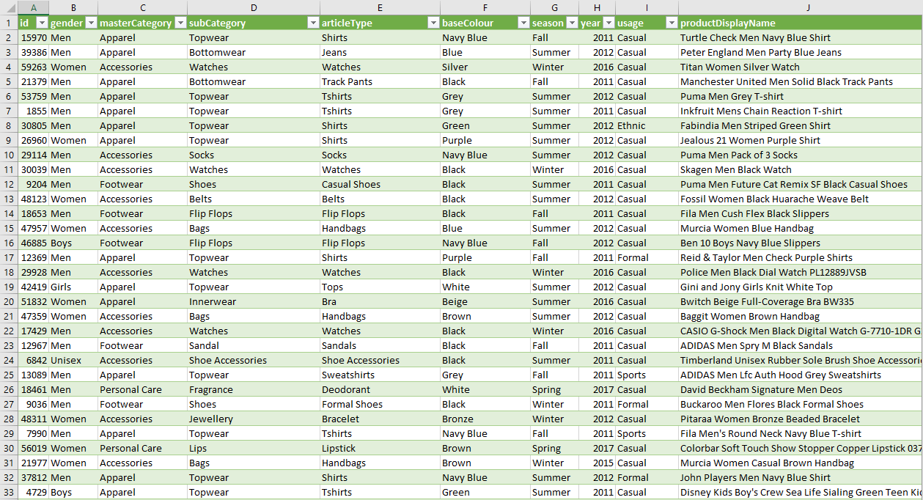
44,446 x 10

Slide 21
44,446 x 6

Slide 22





Data Processing
15,567 x 6
14,298 x 6
14,163 x 6
14,163 x 6
14,159 x 7
1
3
5
2
4
Keep Only Top/Bottom-Wear
Keep Only Men/Women Clothes
Drop Ethnic Usage Clothes
Replace
Null
Values
Create Column Image Path
Notes:
1. Filtered the dataset to keep only Top and Bottom-wear clothing items, removing other categories, but retained 'Shorts' from the 'Loungewear and Nightwear’ subCategory (14 final categories).
2. Excluded gender categories 'unisex', 'boys', and 'girls'; focused only on 'Men' and 'Women' clothing.
3. Dumped clothes designed for Ethnic usage, as we do not want the model to classify these clothes.
4. Replaced null values in the 'usage' and 'season' columns.
5. Created a new column for image paths and removed rows without associated images.

Slide 23
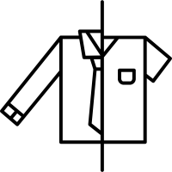




Data Processing (cont.)
14,159 x 7
14,159 x 7
14,000 x 7
14,000 x 12
14,000 x 12
7
9
6
8
10
Update Usage Values
Update Season Values
Data Augmentation
Label Encoding
Save to
CSV
Notes:
6. Recategorized 'Smart Casual', 'Party', and 'Travel' clothes as 'Casual' due to low sample sizes.
7. Updated 'Winter' and 'Spring' clothes to 'Fall/Winter' and 'Spring/Summer' respectively, based on main fashion week seasons.
8. Augmented the dataset by applying image rotations, scaling, and horizontal flips to achieve 1,000 images per articleType.
9. Encoded category labels alphabetically, assigning integer values (e.g., Casual=0, Formal=1, Sports=2).
10. Saved the processed data as a CSV file for distribution among project members for parallel work.

Slide 24
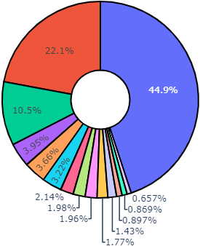
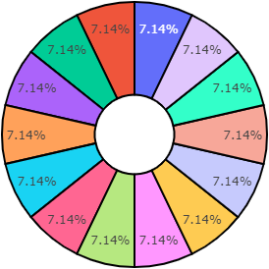
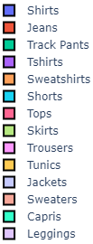
ArticleType Distribution
Augmentation
Before
After

Slide 25
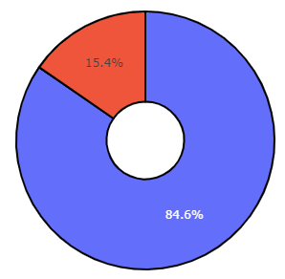
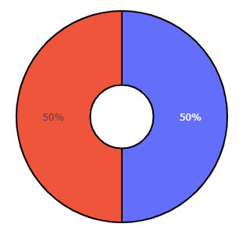

SubCategory Distribution
Augmentation
Before
After

Slide 26
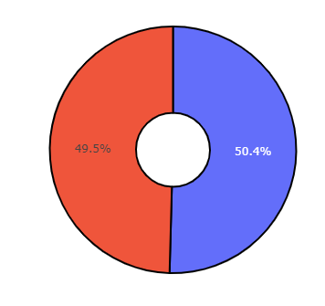
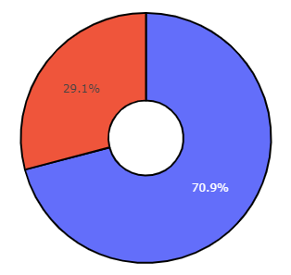
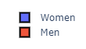
Gender Distribution
Augmentation
Before
After

Slide 27
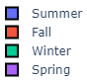
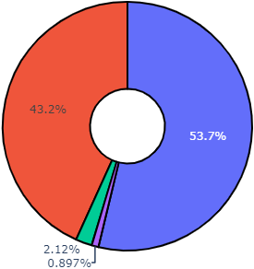
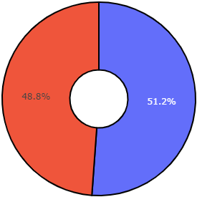
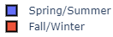
Season Distribution
Augmentation
Before
After

Slide 28
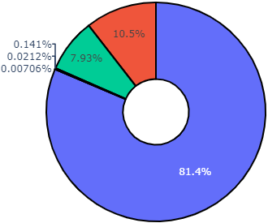
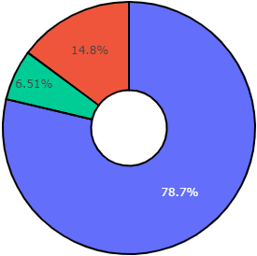
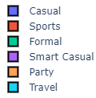
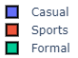
Usage Distribution
Augmentation
Before
After

Slide 29
Algorithms & Experiments
Overview, Setup & Configuration

Slide 30
Algorithms Used
SGD Classifier
Passive Aggressive Classifier
EfficientNetV2-S CNN
ResNet50 CNN
K-Means Clustering

Slide 31
Algorithms
K-Means
Clustering
EfficientNetV2-S
CNN
ResNet50
CNN
Passive Aggressive Classifier
SGD Classifier
START

Slide 32
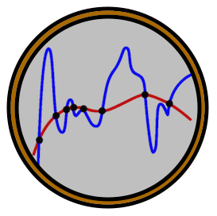
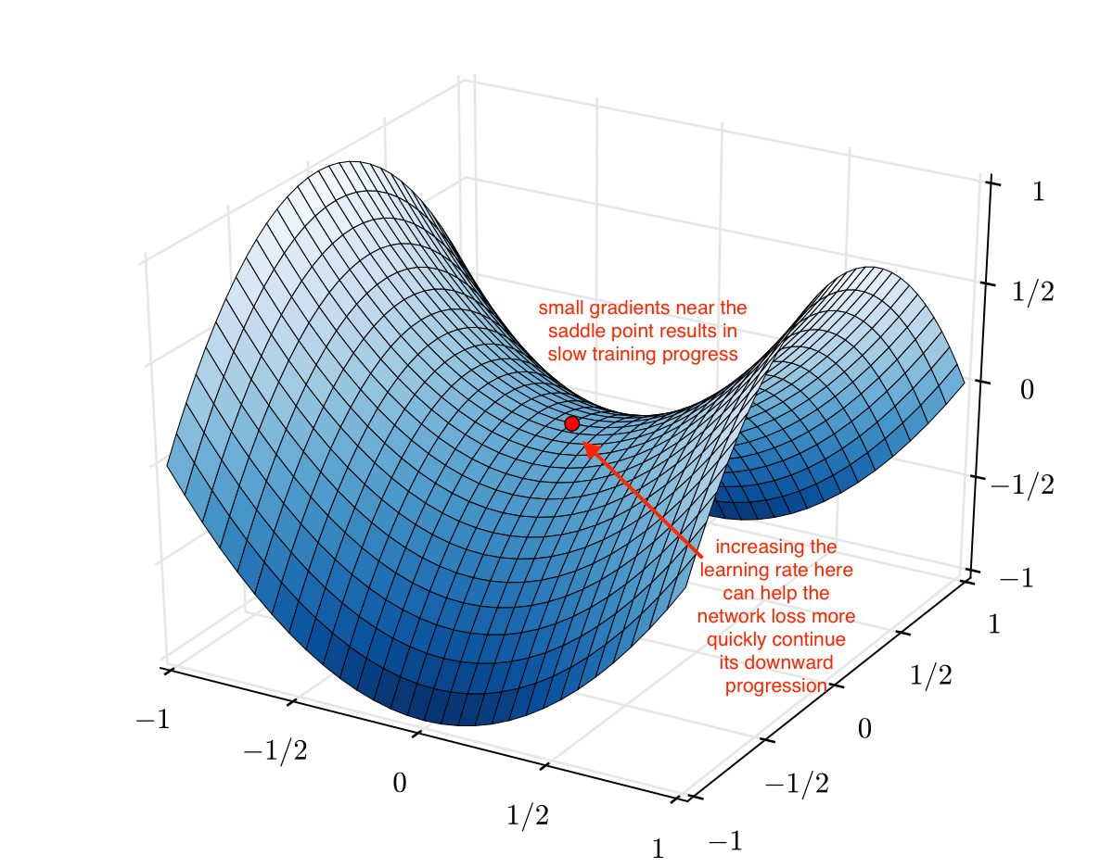
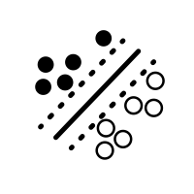



SGD Classifier
Regularization
Learning Rate
Support Vector
Machine
Data Shuffling
Parallel CPU
Multi-Output
Notes:
The idea of SVM is simple: The algorithm creates a line or a hyperplane which separates the data into classes. However, this is done for one output. For multioutput, we use the Multi Output Classifier.
Gradient Descent is an iterative optimization process that searches for an objective function’s optimum value (Minimum/Maximum). It is one of the most used methods for changing a model’s parameters in order to reduce a cost function in machine learning projects. In SGD, instead of using the entire dataset for each iteration, only a single random training example (or a small batch) is selected to calculate the gradient and update the model parameters. This random selection introduces randomness into the optimization process, hence the term “stochastic” in Stochastic Gradient Descent. The advantage of using SGD is its computational efficiency, especially when dealing with large datasets. By using a single example or a small batch, the computational cost per iteration is significantly reduced compared to traditional Gradient Descent methods that require processing the entire dataset.
Two modules from Scikit-Learn are used:
MultiOutputClassifier is used for multi-output classification, and
SGDClassifier is a linear classifier using the Stochastic Gradient Descent (SGD) optimization algorithm.
From hyperparameters of the SGDClassifier used, the most important to mention are:
The hinge loss, which makes this classifier act as a linear Support Vector Machine (SVM).
The use of L2 regularization penalty to prevent overfitting.
Shuffling of training data before each iteration for better convergence.
Using a heuristic-based learning rate (LR) adaptation method, with square root (0.5 exponent) of the previous LR value for inverse scaling learning rate schedule.
Determined to stop training after 5 iterations with no improvement.
Utilizing all available CPU cores for parallelization.
The SGDClassifier model is wrapped in a MultiOutputClassifier. This is used, because we have multiple target variables (multi-output) and want to create a separate classifier for each target variable while sharing the same features. The training of each classifier is parallelized across all available CPU cores.

Slide 33
Algorithms
K-Means
Clustering
EfficientNetV2-S
CNN
ResNet50
CNN
Passive Aggressive Classifier
SGD Classifier
START

Slide 34
Passive Aggressive Classifier
Regularization
Learning Rate
Support Vector
Machine
Data Shuffling
Parallel CPU
Multi-Output
Notes:
Passive Aggressive (PA) classifiers are a type of online learning algorithm that can be used for classification tasks. They are based on the idea of being “passive” when the current model correctly classifies a training example, but “aggressive” when it makes a mistake. They do not require a learning rate. However, they do include a regularization parameter. The PA algorithm is designed for incremental learning and can adapt to changing data over time. It updates the model parameters in response to misclassified examples in an "aggressive" manner to correct errors.
From hyperparameters of the PassiveAggressiveClassifier used, the most important to mention are:
The hinge loss, which makes this classifier act as a linear Support Vector Machine (SVM).
The use of C regularization parameter to prevent overfitting.
Shuffling of training data before each iteration for better convergence.
Utilizing all available CPU cores for parallelization.

Slide 35
Algorithms
K-Means
Clustering
EfficientNetV2-S
CNN
ResNet50
CNN
Passive Aggressive Classifier
SGD Classifier
START

Slide 36


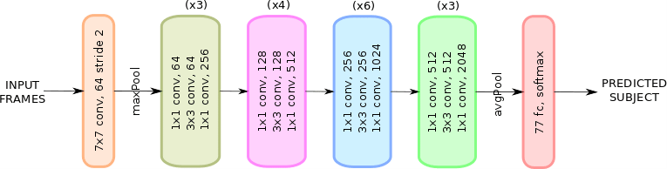

ResNet50 CNN
1 fc, sigmoid
14 fc, softmax
Predicted SubCategory
1 fc, sigmoid
512 fc, ReLU
Predicted ArticleType
3 fc, softmax
flatten
Predicted Gender
1 fc, sigmoid
Predicted Usage
Predicted Season
Notes:
In our project, we leverage the power of Convolutional Neural Networks (CNNs) for image classification tasks. Specifically, we utilize transfer learning from the ResNet50 architecture. ResNet stands for Residual Network and is a specific type of convolutional neural network (CNN) introduced in the 2015 paper “Deep Residual Learning for Image Recognition”. Residual neural networks are a type of artificial neural network (ANN) that form networks by stacking residual blocks. ResNet50 is a 50-layer convolutional neural network (48 convolutional layers, one Max Pool layer, and one Average Pool layer).
Architecture of ResNet-50
1. Now we’ll talk about the architecture of ResNet50. The architecture of ResNet50 has 4 stages as shown in the diagram below. The network can take the input image having height, width as multiples of 32 and 3 as channel width. For the sake of explanation, we will consider the input size as 224 x 224 x 3. Every ResNet architecture performs the initial convolution and max-pooling using 7×7 and 3×3 kernel sizes respectively. Afterward, Stage 1 of the network starts and it has 3 Residual blocks containing 3 layers each. The size of kernels used to perform the convolution operation in all 3 layers of the block of stage 1 are 64, 64 and 128 respectively. The curved arrows refer to the identity connection. The dashed connected arrow represents that the convolution operation in the Residual Block is performed with stride 2, hence, the size of input will be reduced to half in terms of height and width but the channel width will be doubled. As we progress from one stage to another, the channel width is doubled and the size of the input is reduced to half.
2. For each residual function F, 3 layers are stacked one over the other. The three layers are 1×1, 3×3, 1×1 convolutions. The 1×1 convolution layers are responsible for reducing and then restoring the dimensions. The 3×3 layer is left as a bottleneck with smaller input/output dimensions.
3. Finally, the network has an Average Pooling layer followed by a fully connected layer having 1000 neurons (ImageNet class output).
Key Features of ResNet:
1. ResNet uses Batch Normalization at its core. The Batch Normalization adjusts the input layer to increase the performance of the network. The problem of covariate shift is mitigated.
2. ResNet makes use of the Identity Connection, which helps to protect the network from vanishing gradient problem.
3. Deep Residual Network uses bottleneck residual block design to increase the performance of the network.

Slide 37
Algorithms
K-Means
Clustering
EfficientNetV2-S
CNN
ResNet50
CNN
Passive Aggressive Classifier
SGD Classifier
START

Slide 38
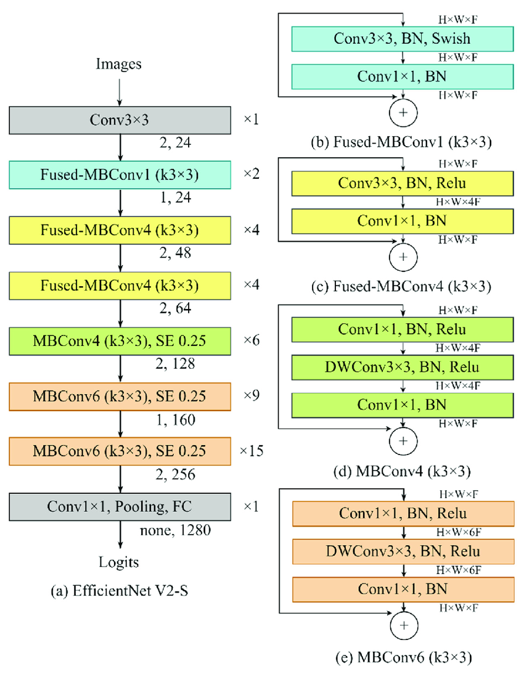
EfficientNetV2-S CNN
avgPool
1 fc, sigmoid
14 fc, softmax
Predicted SubCategory
1 fc, sigmoid
512 fc, ReLU
Predicted ArticleType
3 fc, softmax
flatten
Predicted Gender
1 fc, sigmoid
Predicted Usage
Predicted Season
Notes:
EfficientNetV2 is a type convolutional neural network that has faster training speed and better parameter efficiency than previous models. To develop these models, the authors use a combination of training-aware neural architecture search and scaling, to jointly optimize training speed. The models were searched from the search space enriched with new ops such as Fused-MBConv.
Architecturally the main differences are:
EfficientNetV2 extensively uses both MBConv and the newly added fused-MBConv in the early layers.
EfficientNetV2 prefers smaller expansion ratio for MBConv since smaller expansion ratios tend to have less memory access overhead.
EfficientNetV2 prefers smaller 3x3 kernel sizes, but it adds more layers to compensate the reduced receptive field resulted from the smaller kernel size.
EfficientNetV2 completely removes the last stride-1 stage in the original EfficientNet, perhaps due to its large parameter size and memory access overhead.
Efficientnet v2-s Architecture
(a) represents the schematic of the model from image input to logit output. The numbers indicated on the right side of the boxes represent the layer numbers, while the numbers displayed below the boxes indicate the corresponding stride and channels.
(b-e) are the schematic of each specific algorithm in (a); Fused-MBConv1, Fused-MBConv4 (k3×3), MBConv4 (k3×3), and MBConv6 (k3×3), respectively.
The abbreviations are expanded as follows:
MBConv as mobile vision convolutional network,
SE as squeeze and excitation,
FC as full connect,
DW as depth wise,
BN as batch normalization,
H as height,
W as width and
F as number of channels.
An Inverted Residual Block, sometimes called an MBConv Block, is a type of residual block used for image models that uses an inverted structure for efficiency reasons. It was originally proposed for the MobileNetV2 CNN architecture. It has since been reused for several mobile-optimized CNNs.
A traditional Residual Block has a wide -> narrow -> wide structure with the number of channels. The input has a high number of channels, which are compressed with a 1x1 convolution. The number of channels is then increased again with a 1x1 convolution so input and output can be added.
In contrast, an Inverted Residual Block follows a narrow -> wide -> narrow approach, hence the inversion. We first widen with a 1x1 convolution, then use a 3x3 depthwise convolution (which greatly reduces the number of parameters), then we use a 1x1 convolution to reduce the number of channels so input and output can be added.

Slide 39
Algorithms
K-Means
Clustering
EfficientNetV2-S
CNN
ResNet50
CNN
Passive Aggressive Classifier
SGD Classifier
START

Slide 40





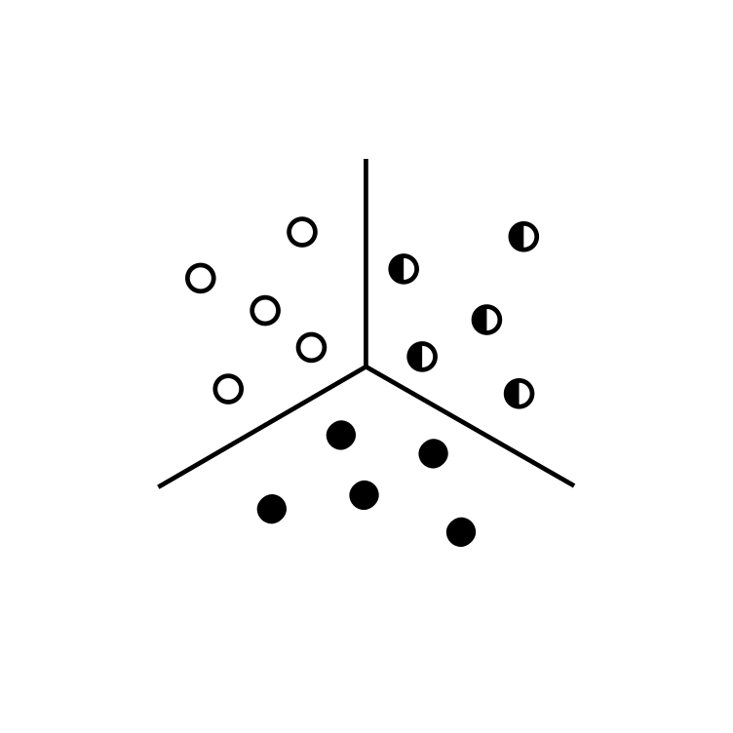


K-Means Clustering
Read Image
Crop Image
Resize Image
Reshape Image
K-Means on Pixels
Identify Dominant RGB Color
Find Closest Color in Dataset
Notes:
It's a simple image processing pipeline for color analysis. Αn image is loaded, cropped, resized, reshaped, performed K-Means clustering to identify the dominant color, and then the name of the dominant color is returned.
The image is resized to a smaller size (64x64 pixels). Then, the color channels are reordered from BGR to RGB.
Then, the reshaping of the image is done. It flattens the 64x64 image into a one-dimensional array where each element represents a pixel in RGB format.
K-Means clustering is applied to the pixel data with n_clusters=5. This means the algorithm will attempt to group the pixels into five clusters, aiming to identify the five most dominant colors in the image.
The number of pixels assigned to each cluster label is rounded, and the cluster with the highest count is considered the dominant color. The RGB values of this dominant color are rounded to integers.

Slide 41



Model Setup & Configuration
Preprocessing
Data Split
Training Dataset
Original Dataset
Test Dataset
Stratification
Notes:
For all models, we applied a load and preprocess function for images to load them, resize them to a common size (we used 224x224 pixels) and normalize pixel values to the range [0,1].
We also divided the dataset to training, validation, and test sets with a ratio of 80%, 10%, and 10% of the original dataset respectively, stratifying on an artificial column created from the five output/target columns.
Stratification ensures that each subset contains a representative sample from each class, maintaining the same class distribution as the original dataset.

Slide 42

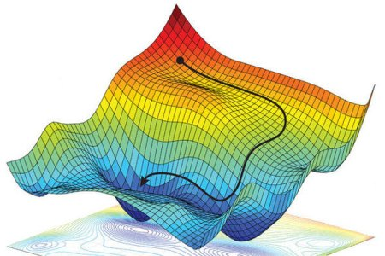

Baseline (SVM) Models
partial_fit(X_train, y_train, classes=classes)
SVM
SGD Classifier
(t=1.5 min)
Passive-Aggressive Classifier
(t=1.5 min)
Multi-Output Classifier
Notes:
At start, we applied the first two models in order to have a baseline model that is less resource-hungry before applying CNNs, which are known to have better results than typical machine learning models with larger training cost (time and resources). For these models, no special hardware or software configuration needed, apart from applying the scikit-learn’s ‘partial_fit’ method, which provides the ability to learn incrementally from a mini-batch of instances (sometimes called “online learning”), which is a good strategy to scale computationally bigger data. This method is key to out-of-core learning as it guarantees that at any given time there will be only a small number of instances in the main memory.
Multi target classification was applied with the use of scikit-learn’s MultiOutputClassifier. This strategy consists of fitting one classifier per target. This is a simple strategy for extending classifiers that do not natively support multi-target classification. MultiOutputClassifier was applied with the maximum available number of processes/threads to run in parallel.
For the first model, scikit-learn’s SGDClassifier was used, as the model of the MultiOutputClassifier, with hinge loss, squared Euclidean norm L2 penalty, shuffling of data and all other hyperparameters in their default values, in order to effectively apply SVM. The training lasted approximately for 1.5 minute.
For the second model, scikit-learn’s PassiveAggressiveClassifier was used with hinge loss, shuffling of data and all other hyperparameters in their default values. The training lasted for approximately 1.5 minute.

Slide 43


Slide 44

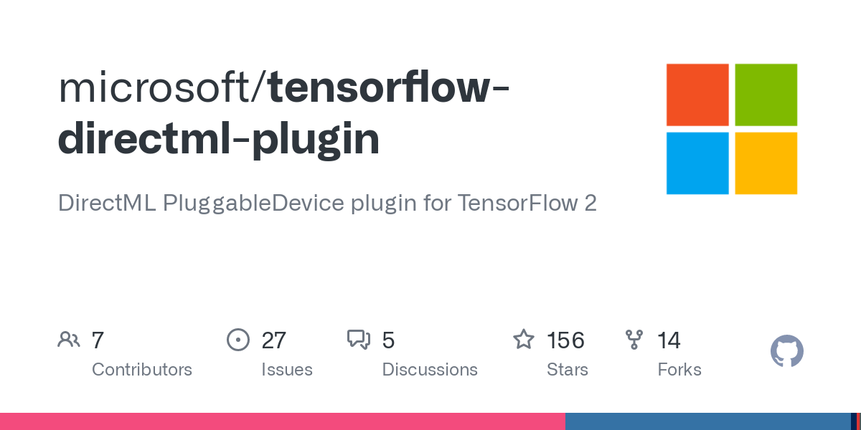







CNN Models: Challenges
Notes:
Then, we started training our CNN models.
Because none of the members of this project owned a PC with an NVIDIA GPU installed, at first, we started training our models on our CPU, but the training time of a single epoch lasted from 50 minutes to 1 hour and 5 minutes, depending on the pre-trained CNN, layers, and the tuning of hyperparameters.
Then, because we had internal Intel GPU, we tried the Direct ML Plugin for Tensorflow 2. We followed all instructions mentioned here, we saw our GPU usage reaching 100%, but the training of a single epoch lasted more time, starting with 1 hour and 10 minutes.
Then, we tried installing Tensorflow from Anaconda, with the command:
pip uninstall tensorflow conda install tensorflow
We observed a slightly faster CPU performance, starting from 40 minutes per epoch instead of 50 minutes. It was indeed a performance, but not a 8.6x as mentioned here for ResNet50 model.
Then, we tried to build Tensorflow from source on Windows, following the instructions mentioned here, but all attempts (and there were several of them) failed.
Lastly, we ended up training our models in the cloud, with the use of Google Colaboratory (mostly) and Paperspace Gradient Console (less) at a time of approximately 20 minutes per epoch.
The time mentioned above for all trials were done on the initial dataset of 50k rows. When used the 14k dataset, the time dropped to 15 minutes per epoch on CPU and 3 minutes per epoch on GPU.

Slide 45

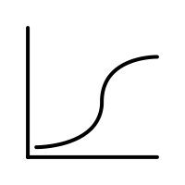
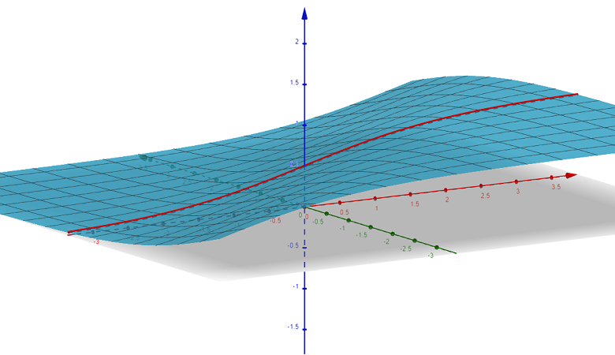







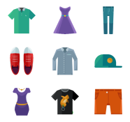


CNN Models: Common Configurations
Version 2.13
Early Stopping
Model Checkpoint
Notes:
The CNN models were built using Tensorflow v2.13.0 API popular deep learning framework. For the five output layers of all models, we used:
a sigmoid activation function with a binary cross-entropy loss for the binary outcomes (gender, season, and subCategory) and
a SoftMax activation function with sparse categorical cross-entropy loss (the encoded labels were integers and not one-hot-encoded labels) for the outcomes having more than two categories (usage and articleType).
Also, for all models, we applied an Early Stopping Callback with a patience of 10 epochs and a Model Checkpoint Callback to store the weights of the best epoch with respect to the minimum validation loss.

Slide 46



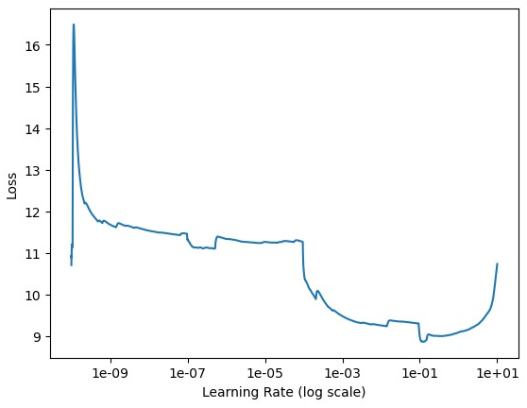

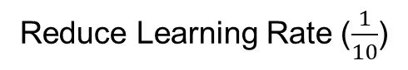
CNN Models: Variant #1
1 fc, sigmoid
14 fc, softmax
SubCategory: [0,1]
a. (None, 2048)
Flatten Layer a.(None,2048) b.(None,1280)
1 fc, sigmoid
512 fc, ReLU
ArticleType: [0..13]
1 fc, sigmoid
Gender: [0,1]
3 fc, softmax
b. (None, 1280)
Season: [0,1]
Usage: [0,1,2]
Input Layer [(None,224,224,3)]
Range Best Learning Rates
Reduce Learning Rate ($\frac{1}{10}$)
ResNet50: 61 epochs
EfficientNetV2-S: 77 epochs
Notes:
The first variant included the Input Layer, the respective preprocessing input layer for each model (ResNet/EfficientNetV2), the respective pre-trained frozen-layer model, a flatten layer, a Rectified Linear Unit activation function dense layer, and the five output layers with a callback to reduce the Adam optimizer learning rate by 10, with a patience of 5 epochs of no decrease in validation loss. The range of best learning rates to start with and end to were found with a custom best-learning-rate-finder (LRFinder) function to be in the range [0.0001, 0.1]. The models were set to train for 100 epochs and stopped due to early stopping callback at the 61st and 77th epoch respectively for ResNet50 and EfficientNetV2S.

Slide 47

CNN Models: Variant #2
1 fc, sigmoid
14 fc, softmax
SubCategory: [0,1]
a. (None, 2048)
Flatten Layer a.(None,2048) b.(None,1280)
1 fc, sigmoid
512 fc, ReLU
ArticleType: [0..13]
1 fc, sigmoid
Gender: [0,1]
3 fc, softmax
b. (None, 1280)
Season: [0,1]
Usage: [0,1,2]
Input Layer [(None,224,224,3)]
Stable Learning Rate (0.001)
ResNet50: 60 epochs
EfficientNetV2-S: 80 epochs
Notes:
The second variant was exactly the same with the first variant, with the only difference that the Adam optimizer learning rate remained stable at the default value of 0.001. The models trained for 60 and 80 epochs respectively, before stopping due to the Early Stopping Callback.

Slide 48
CNN Models: Variant #3
1 fc, sigmoid
14 fc, softmax
SubCategory: [0,1]
a. (None, 2048)
Flatten Layer a.(None,2048) b.(None,1280)
1 fc, sigmoid
512 fc, ReLU
ArticleType: [0..13]
1 fc, sigmoid
Gender: [0,1]
3 fc, softmax
b. (None, 1280)
Season: [0,1]
Lambda Layer, (None,224,224,3)
Usage: [0,1,2]
Lambda Layer, (None,224,224,1)
Input Layer [(None,224,224,3)]
Stable Learning Rate (0.001)
ResNet50: 72 epochs
EfficientNetV2-S: 77 epochs
Notes:
The third variant was exactly the same with the second, with the addition of 2 Lambda functions in the architecture, after the input layer and before the pre-trained model layer, that convert the images to grayscale and again to RGB (because the models accept only images with three channels and not one). This was included because we do not gain anything from the color for classifying an image if it is for Men/Women, it is Jeans or Trousers, Topwear/Bottomwear, Formal/Casual and if it is to be worn in the summer or in the winter. Even a person with color deficiency can recognize these features. The models trained for 72 and 77 epochs respectively, before stopping due to the Early Stopping Callback.

Slide 49

CNN Models: Variant #4
1 fc, sigmoid
14 fc, softmax
SubCategory: [0,1]
a. (None, 2048)
Flatten Layer a.(None,2048) b.(None,1280)
1 fc, sigmoid
Dropout (0.2)
512 fc, ReLU
ArticleType: [0..13]
1 fc, sigmoid
Gender: [0,1]
3 fc, softmax
Season: [0,1]
b. (None, 1280)
Lambda Layer, (None,224,224,3)
Usage: [0,1,2]
Lambda Layer, (None,224,224,1)
Input Layer [(None,224,224,3)]
Stable Learning Rate (0.0001)
ResNet50: 25 epochs
EfficientNetV2-S: 35 epochs
Notes:
The fourth variant was exactly the same with the third, with two exceptions. Firstly, the unfreezing of the top n layers of the pre-trained model (effectively achieving this way transfer learning) in order to fine-tune the pre-trained model on our dataset. For the ResNet50 pre-trained model we unfroze the top 8 out of the 176 layers and for the EfficientNetV2S we unfroze the top 64 out of the 514 layers. Secondly, we added a Dropout layer with a 0.2 rate before the ReLU activation function for regularization. The models trained for 25 and 35 epochs respectively, before stopping due to the Early Stopping Callback.

Slide 50
Results & Quantitative Analysis
Accuracy, Loss, Confusion Matrix, Classification Report & ROC Curve

Slide 51
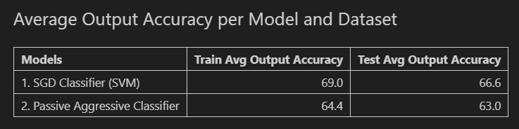
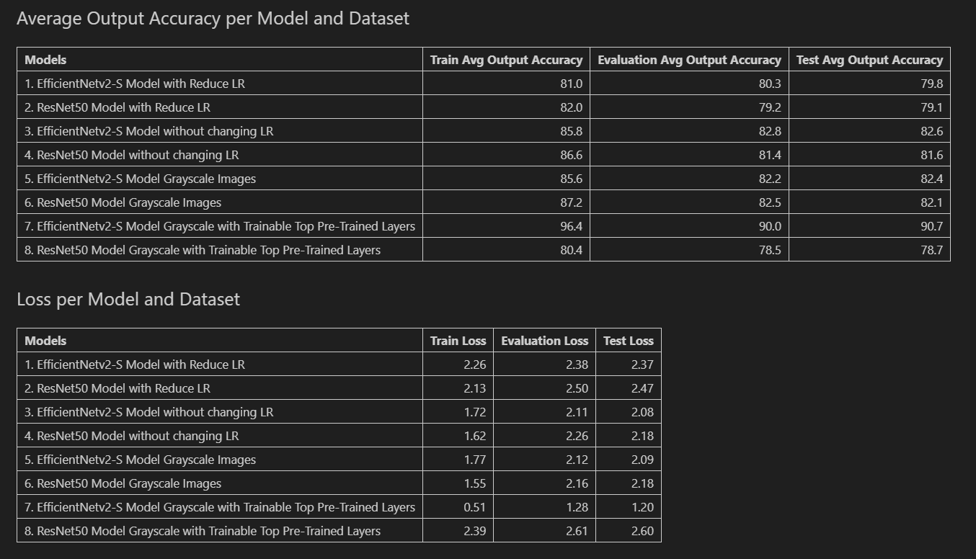
Models Accuracy

Slide 52
CNN Models Loss

Slide 53
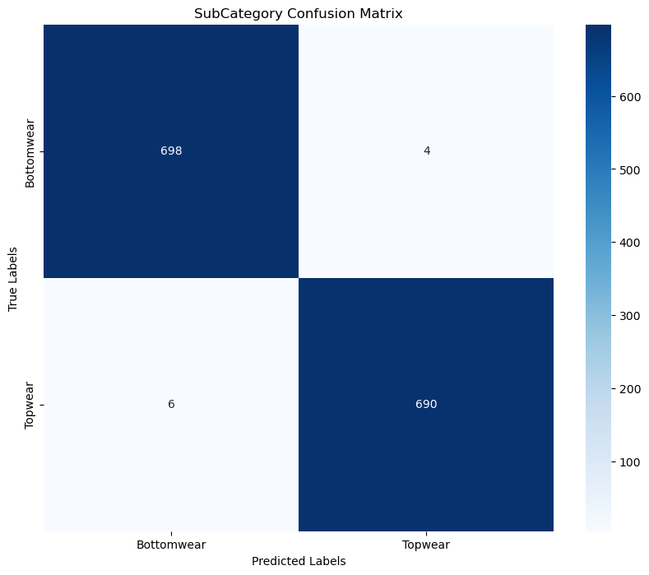
SubCategory: Confusion Matrix

Slide 54
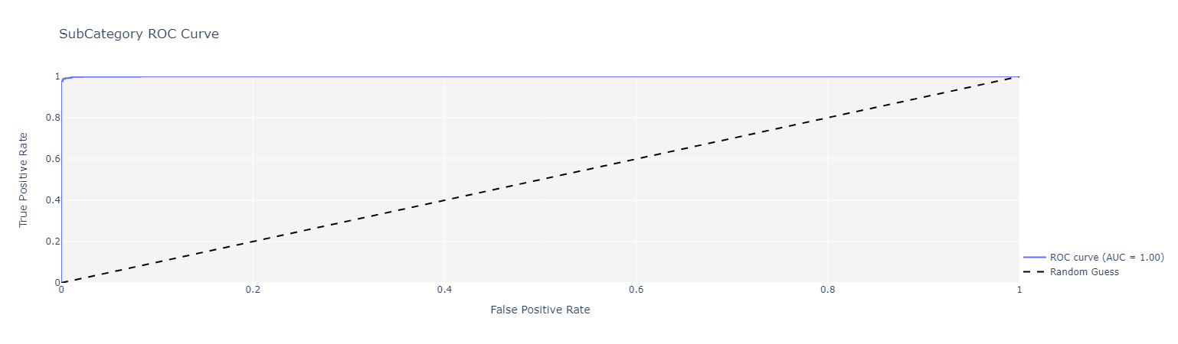
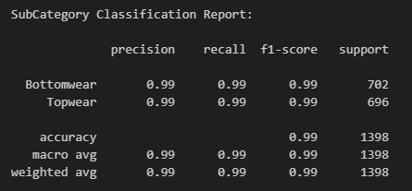
SubCategory: Classification Report & ROC Curve

Slide 55
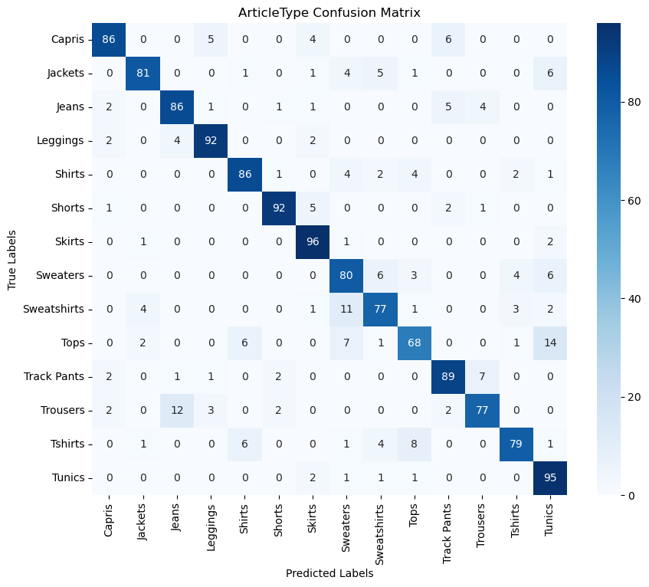
ArticleType: Confusion Matrix

Slide 56
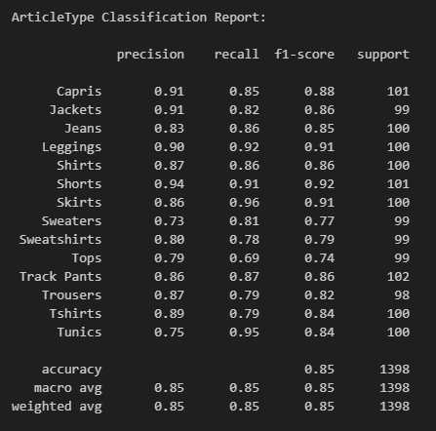
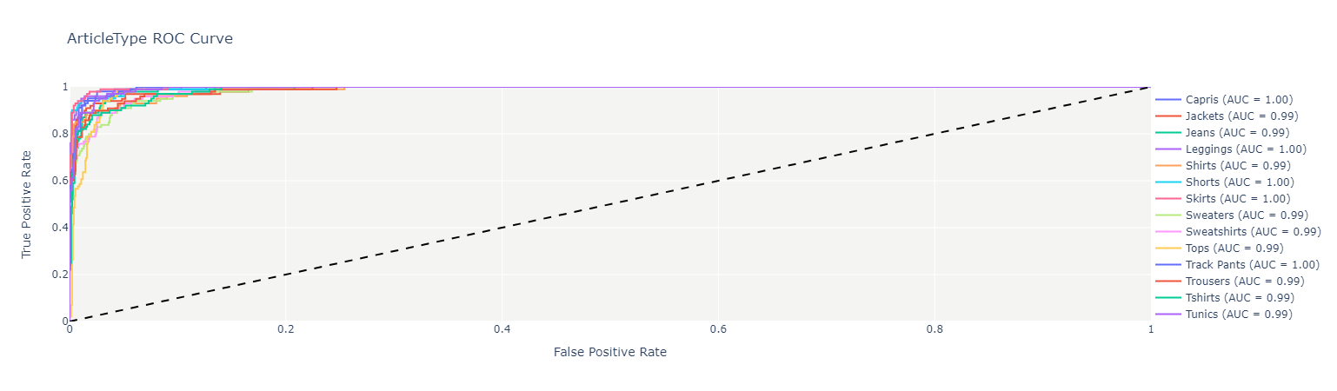
ArticleType: Classification Report & ROC Curve

Slide 57

Gender: Confusion Matrix

Slide 58


Gender: Classification Report & ROC Curve

Slide 59

Usage: Confusion Matrix

Slide 60


Usage: Classification Report & ROC Curve

Slide 61

Season: Confusion Matrix

Slide 62


Season: Classification Report & ROC Curve

Slide 63
Qualitative & Error Analysis
Overfitting, Season Output Misclassification

Slide 64


Resnet50 Overfitting Signs
Notes:
For the last variant of our models, we observed signs of overfitting. Because of these signs, we specified to the Model Checkpoint Callback to store each best epoch without overwriting the previous. In the figures below, it can be observed that as epochs pass, the model tends to overfit on the training data, thus not being able to generalize on new unseen data. Thus, for the ResNet50 model the 3rd epoch’s weights were loaded as the best and for the EfficientNetV2S model the 19th epoch’s weight were loaded as the best.

Slide 65


EfficientNetV2-S Overfitting Signs
Notes:
For the last variant of our models, we observed signs of overfitting. Because of these signs, we specified to the Model Checkpoint Callback to store each best epoch without overwriting the previous. In the figures below, it can be observed that as epochs pass, the model tends to overfit on the training data, thus not being able to generalize on new unseen data. Thus, for the ResNet50 model the 3rd epoch’s weights were loaded as the best and for the EfficientNetV2S model the 19th epoch’s weight were loaded as the best.

Slide 66





Season Output Misclassification
Notes:
Generally, the best variant model has good performance on classifying clothes on the five forementioned output labels. We can observe a loss in its performance (80% on the test dataset) for the season output.
274 out of 1398 products of the test dataset were misclassified. The original distribution as it was in the test dataset is maintained in the misclassifications, so we cannot see a pattern causing the misclassifications.
That’s maybe because of the intermediate seasons (Fall and Spring) that clothes have a thicker fabric but can be with short or no sleeves. Also, the lack of data for these seasons and the manual update of the season column from 4 labels (4 year’s seasons) to 2 labels (2 fashion runway seasons) can be the explanation to this misclassification rate.

Slide 67


Notes:
3

Slide 68
Discussion
Web App Development, Mobile App Mockup, Market Validation, Revenue Streams & Future Work

Slide 69


DressMeApp

Slide 70

Mobile App
Mockup
Notes:
Streamlit does not provide, so far, a way to construct an Android/Apple application. Because we understand that users prefer to take photos of their clothes and use a mobile app that is always with them. So, in the future we will also create a mobile application. Until then, we have created a mockup screen using proto.io, as seen in the figure below.

Slide 71



Market Validation - Evidence
Source: https://dressmeup.tech/
Source: https://www.instagram.com/dressmeup.tech/
Notes:
We also registered with the use of “Papaki” web hosting provider, the use for 1 year of the following domains: dressmeup.tech and dressmeup.site. Then, we issued a web hosting packet to accommodate the former domain. Then, with the use of “Papaki” for a month we built our web page and for a month we bought an SSL package in order to provide a secure socket layer to our webpage visitors to ensure them that they are safe when entering their contact information. Our webpage is https://dressmeup.tech, but was available for anyone to visit until 15/09/2023, when the Website Builder Packet expired. The site was built for educational purpose.
We also created an Instagram account (https://www.instagram.com/dressmeup.tech), in order to be able to advertise our company to future customers, link them to our web application and webpage, post news and features of the application and in general to familiarize the market with our business idea. The goal of the forementioned procedure was to track the market’s interest in our business idea by advertising the features of our application (mock-up screens) and persuading future customers that are socially active in Instagram (the most popular social media for younger aged people) to land to our website landing page and express their interest for the application through an e-mail subscription (the e-mail with the message would be sent to one of our e-mails – tested that it was working).

Slide 72
Market Validation - Evidence
Notes:
Customer Validation was done through Instagram advertisements. We created a post to evaluate the interest in our business idea. We did 3 types of advertisement campaign: an Instagram Story for no targeted audience, an Instagram Post for no targeted audience and an Instagram Post for targeted fashion-interested audience. The results are shown in the table below

Slide 73

Market Validation - Evidence
Notes:
The interest in our business idea increased for fashion-interested people. We can observe that, for the fashion-interested people that clicked our advertisement across all age groups, the female customer segment presented a larger attraction towards our business idea and gave back more clicks than the male customer segment. In particular, the age group of 18-24 years old introduced a larger interest in our application and broke the 20% barrier of clicking back the ad and landing to our Instagram account in order to get more information. However, from all people that clicked any of the forementioned advertisement campaigns created, none expressed their interest via filling their e-mail in our website’s landing page.

Slide 74




Business Model Revenue Streams
User gives 10% of the price of every clothing sold
Free charge per sold clothing, but annual fee
Monthly fee for the API use in the e-shop website
Fashion companies monthly fee for promoting their clothes in the recommendation algorithm
Notes:
Our company will generate revenues from the following:
The 10% of the price of each item sold by the users.
An annual fee from all premium users, who will not pay 10% per item sold.
A direct API monetization fee for the API use in the e-shop websites.
A small proportion to the price fee from fashion companies for promoting their clothes in the recommendation algorithm.
Our application will start being used for free with no ads in it by users who want to organize their wardrobe and dressing occasions. While our recommendation algorithm proposes the least used clothes to be sold to other users of the application, users will be persuaded to sell their clothes and thus earn money, leading to our company also earning money from a small percent of the price each cloth will be sold. As users will get used to this habit of selling their unused wardrobe, they will want to spend less as a fee for using our app, so they will achieve that from having a premium account with annual fee. The payment of the users will be executed via Credit Card, Debit Card, or PayPal.
Fashion e-shop websites, that wish to provide more functionalities to their website, making it more attractive for customers, will pay a direct API monetization fee for a thousand calls of our API from users. Fashion companies that want our AI algorithm to propose recommendations for their clothes for matching the app users’ wardrobe will pay a small proportion to price fee.
However, for the latter type of revenue to come there must firstly come the former, but the revenues created from our B2B customers is estimated to contribute more to our overall revenues.

Slide 75





Future Work
App Improvement
Plan Outfits (Weather Forecast)
Sell & Buy Option
Web App UI/UX Improvement
Data & Algorithms
App Development
Collect/Create more/better Data
Image Segmentation
Mobile Application
API
Notes:
Image Segmentation
Collect/Create more/better Data
Plan Outfits Improvement (Consider Weather Forecast)
Sell & Buy Option
Web App UI/UX Improvement
Mobile App Development
API Development

Slide 76
Our Team
Roles & Time Plan

Slide 77




Our Business Roles
Kostas Vlassis Chief Executive Officer
Lefteris Souflas Chief Technology Officer
Dimitris Tsapatsaris Chief Sales Officer
Manolis Sakellaris Chief Financial Officer

Slide 78











Our Project Roles

Slide 79
Time Plan
Week | Days | Description
1 | July 3 - July 9 | Project Kick-off and Planning
2 - 3 | July 10 - July 23 | Business Planning
2 - 4 | July 10 - July 30 | Data Collection and Preprocessing
4 - 7 | July 24 – August 20 | Website Creation and Market Validation
5 - 7 | July 31 – August 20 | 1st AI Model Development
8 - 11 | August 21 - September 17 | Models Development (Cont.)
8 - 11 | August 21 - September 17 | Streamlit Application Development

Slide 80
Week 1 | Week 2 | Week 3 | Week 4 | Week 5 | Week 6 | Week 7 | Week 8 | Week 9 | Week 10 | Week 11
Project Kick-off/ Planning | Business Planning |  | Website Creation and Market Validation |  |  |  |  |  |  | Project Report
 | Data Collection and Preprocessing |  |  | 1st AI Model Development |  |  | Streamlit Application Development
 |  |  |  |  |  |  | Models Development (Cont.)
Time Plan Diagram

Slide 81
THANK YOU
START

